Slide 1




Georeferencing Overview
University of Florida
Sarah Ellen Strickland
Adapted from slides created by Blaine Marchant, Grant Godden, and Charlotte Germain-Aubrey
Notes:
Hi, My name is Sarah Ellen – and today I’m going to talk a bit about georeferernicing. But first, I want to give a big shoutout to Blain, Grant, Charlotte and the countless other Soltis lab members who have setup and contributed to this presentation.

Slide 2


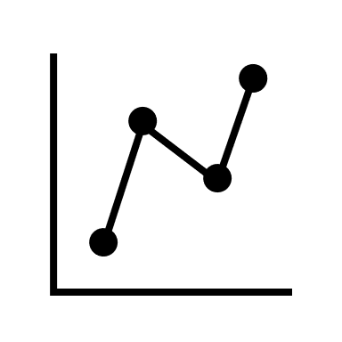



Agenda
What is a georeference?
Why georeference?
Key Concepts
How do you georeference?

Slide 3
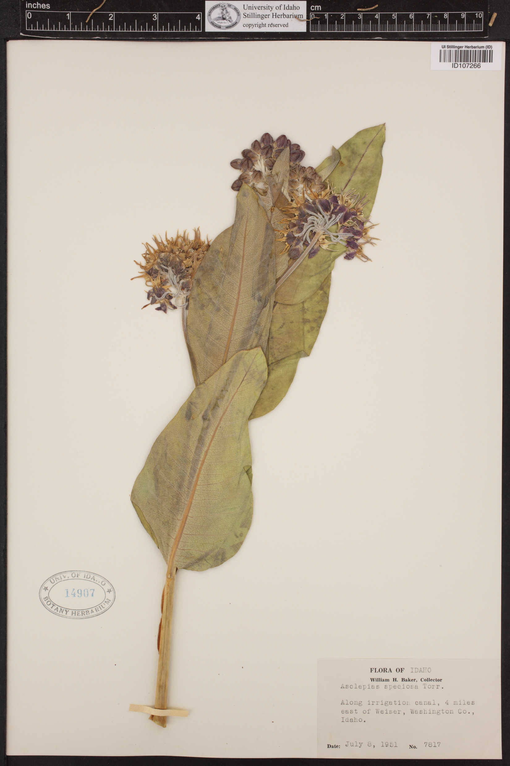
What is georeferencing?

Slide 4
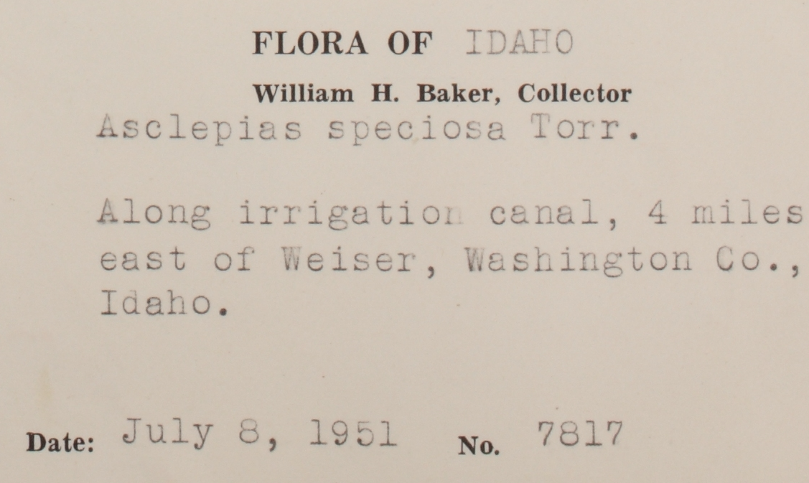
What is georeferencing?

Slide 5
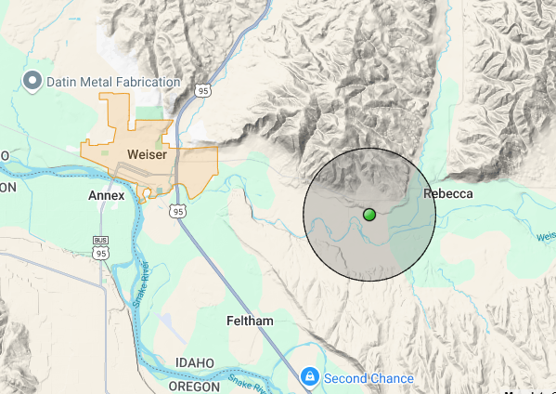
What is georeferencing?

Slide 6
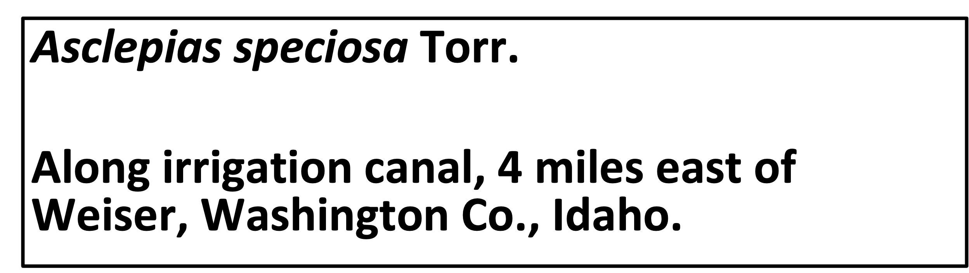
What is georeferencing?
44.23, -116.88
Uncertainty: 1956 m

Slide 7
What is a georeference?
44.23, -116.88
Uncertainty: 1956 m
A numerical description of a place that can be mapped

Slide 8





Agenda
What is a georeference?
Why georeference?
Key Concepts
How do you georeference?

Slide 9
Why georeference?

Slide 10
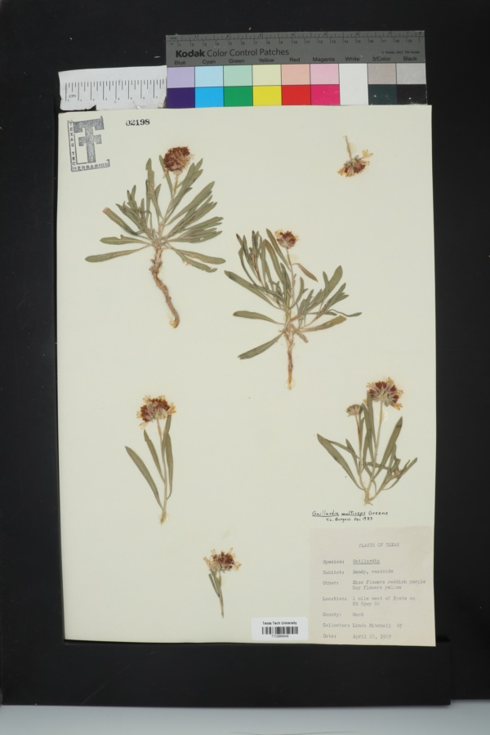
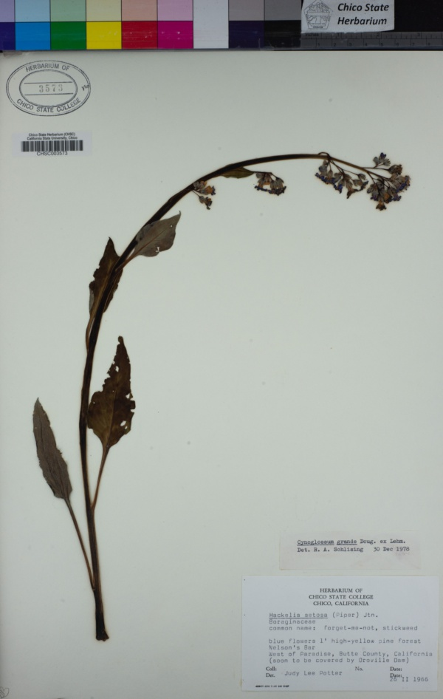
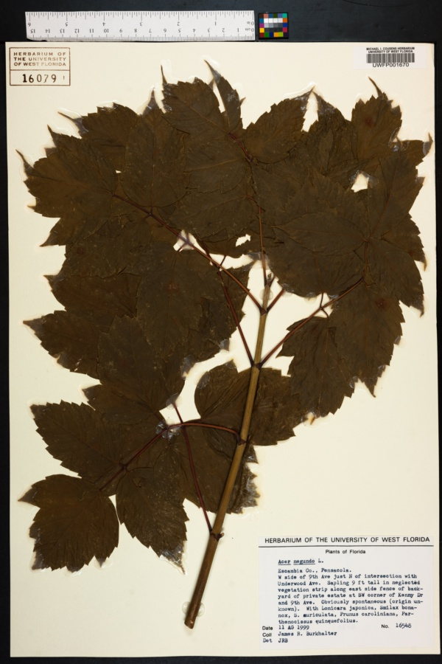
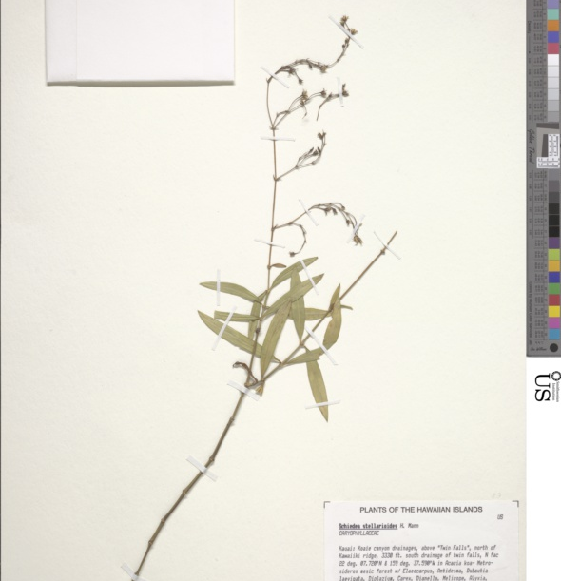
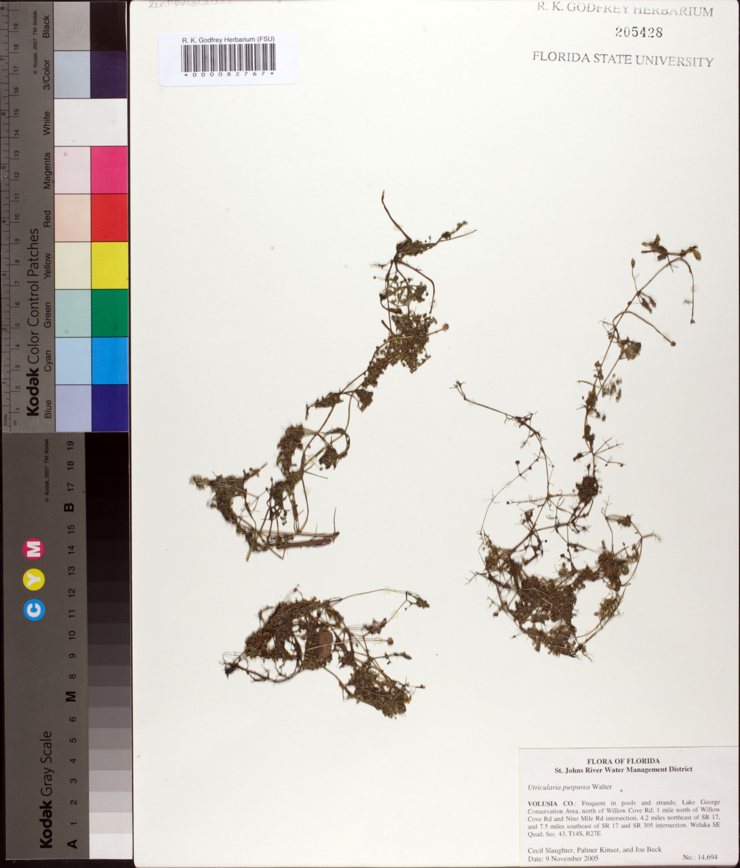
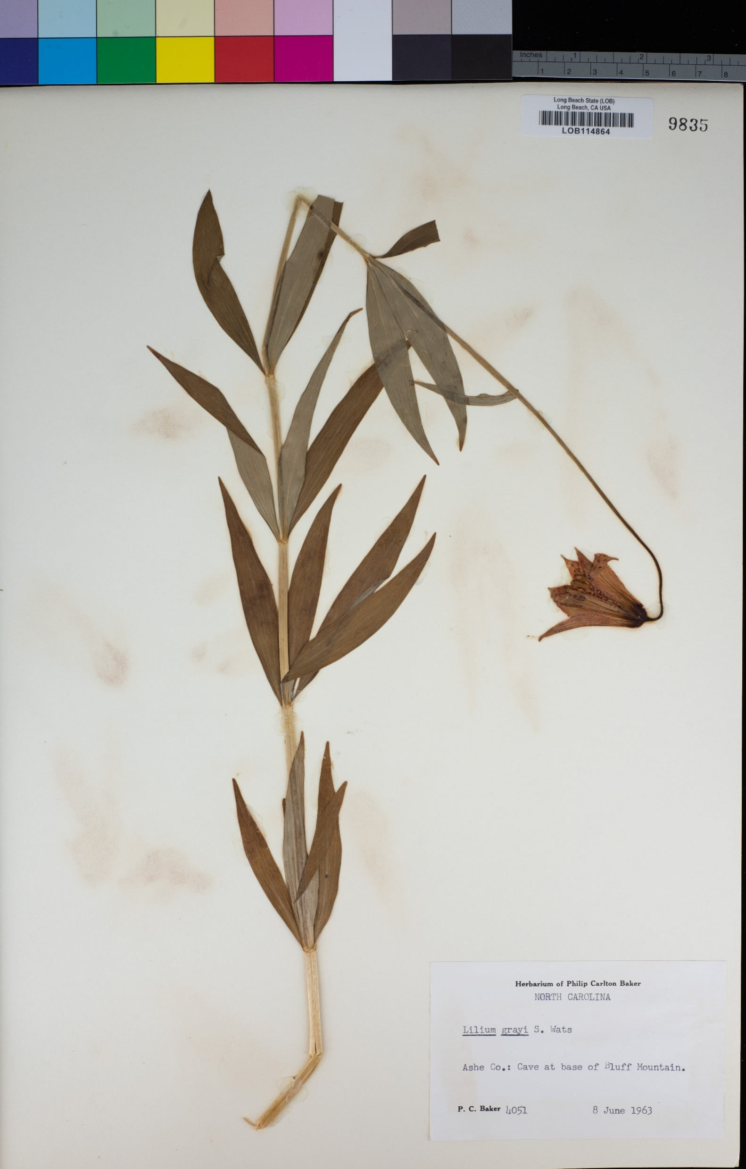

More occurrence data
Notes:
- There’s a wealth of herbarium specimens that do not have coordinate data - > processing these can be beneficial to model development, especially when there are limited occurrence records available

Slide 11






More occurrence data
Notes:
Georefernicng helps us locate previously collected samples – allowing us to include data not collected specifically for this project (or even with any vague awareness that this kind of project could and would exit)…. This opens up a world of potential when it comes to older herbaria records

Slide 12




Filter by uncertainty
Additional reliable data
Notes:
- There’s a wealth of herbarium specimens that do not have coordinate data - > processing these can be beneficial to model development, especially when there are few contemporaneous samples available

Slide 13





Why georeference?
Findable
Accessible
Interoperable
Reusable
Notes:
Aditionally georeferncing can be a part of bringing data up to FAIR standards…..

Slide 14



Why georeference?
Findable
Accessible
Interoperable
Reusable
Latitude:
Longitude:
Uncertainty (m):
44.23
-116.88
1956
Notes:
…. Up to FAIR standards by:
STANDARDIZING outputs – turning highly variable strings into a set of Darwin Core Standards that can be batch analyzed
This also makes the data more reusable – able to more easily filter to records that are applicable for a broad rane of studies

Slide 15



Agenda
What is a georeference?
Why georeference?
Key Concepts
How do you georeference?

Slide 16
What is georeferencing?
44.23, -116.88
Uncertainty: 1956 m
Notes:
Coming back to the first set of slides we talked about georeferenced records as having an location (lat/long) – and an uncertainty

Slide 17


A numerical description of a
place that can be mapped
Coordinates
Uncertainty
44.23, -116.88
1956 m

Slide 18
Coordinate Formats
36º 31' 21.4" N
114º 09' 50.6" W
−36.524276,
−114.164055
36º 31.4566’N
114º 09.8433’W
Degrees minutes and seconds
(DMS)
Decimal degrees
(DD)
Degrees and decimal minutes
(DDM)
Notes:
Few different “Standard” coordinate formats
Old herbarium samples that have coordinates likely to be in Degree minutes and seconds – but current standard today is decimal degrees

Slide 19
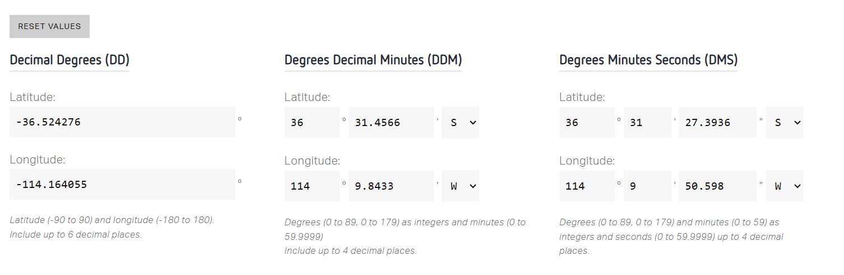
Coordinate Formats
https://applications.pgc.umn.edu/convert/
Notes:
Many tools available to easily convert among formats

Slide 20
Coordinate Formats
https://applications.pgc.umn.edu/convert/
Batch Degree Conversion:
https://blog.batchgeo.com/convert-latitude-longitude-to-decimals-excel/
Notes:
And this website will walk you how to do batch conversion in excel, if needed

Slide 21
A numerical description of a
place that can be mapped
Coordinates
Uncertainty
44.23, -116.88
1956 m

Slide 22
Uncertainty
Every location has associated uncertainty
coordinateUncertaintyInMeters
There are MANY different sources
Locality Description
Point Location
Mapping
Distance measurement precision
Locality extent
Map scale and Coordinate Reference Systems
Coordinate Precision
and
Direction measurement precision
GPS accuracy

Slide 23
Uncertainty in Locality Descriptions
“3 miles north of Palm Springs”
Notes:
Aside from the reference system itself, the nature of the description per se can also lead to increased uncertainty…
For example…. In this locality description, what is meant by:

Slide 24
Uncertainty in Locality Descriptions
“3 miles north of Palm Springs”
3.0 miles?
2.75 miles?
3.03 miles?
Notes:
Aside from the reference system itself, the nature of the description per se can also lead to increased uncertainty…

Slide 25
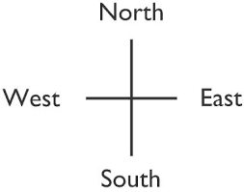
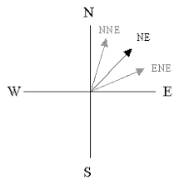
Uncertainty in Locality Descriptions
“3 miles north of Palm Springs”
3.0 miles?
2.75 miles?
3.03 miles?
Notes:
Similarly – the precision/number of coordinate digits recorded corresponds to its own area of space
So depending on how precise your coordinates are – the specific point you identify on a map may be larger (or potentially smaller…..) than the actual extant of what it is that you are locating….. This is something that can factor into your uncertainty
While coordinate precision is one thing that may impact your unctertainty – another thing that can impact it is the way you model Earth itself

Slide 26
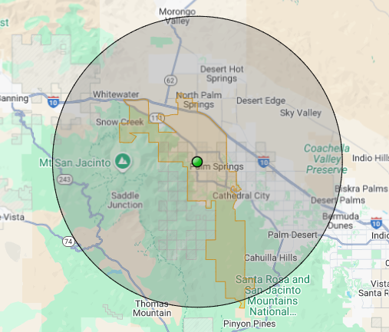
Uncertainty in Locality Descriptions
“3 miles north of Palm Springs”
3.0 miles?
2.75 miles?
3.03 miles?
Notes:
Similarly – the precision/number of coordinate digits recorded corresponds to its own area of space
So depending on how precise your coordinates are – the specific point you identify on a map may be larger (or potentially smaller…..) than the actual extant of what it is that you are locating….. This is something that can factor into your uncertainty
While coordinate precision is one thing that may impact your unctertainty – another thing that can impact it is the way you model Earth itself

Slide 27
Uncertainty in Locality Descriptions
“3 miles north of Palm Springs”
3.0 miles?
2.75 miles?
3.03 miles?
Convert the decimal -> fraction,
Uncertainty = 1/denominator
45 degrees either direction from given cardinal direction
Distance from center point to furthest part of polygon
Notes:
Similarly – the precision/number of coordinate digits recorded corresponds to its own area of space
So depending on how precise your coordinates are – the specific point you identify on a map may be larger (or potentially smaller…..) than the actual extant of what it is that you are locating….. This is something that can factor into your uncertainty
While coordinate precision is one thing that may impact your unctertainty – another thing that can impact it is the way you model Earth itself

Slide 28
Uncertainty in Locality Descriptions
3.0 miles?
2.75 miles?
3.03 miles?
MaNIS/HerpNet/ORNIS Georeferencing Guidelines
Notes:
Similarly – the precision/number of coordinate digits recorded corresponds to its own area of space
So depending on how precise your coordinates are – the specific point you identify on a map may be larger (or potentially smaller…..) than the actual extant of what it is that you are locating….. This is something that can factor into your uncertainty
While coordinate precision is one thing that may impact your unctertainty – another thing that can impact it is the way you model Earth itself

Slide 29
Uncertainty
Locality Description
Point Location
Mapping
Distance measurement precision
Locality extent
Map scale and Coordinate Reference Systems
Coordinate Precision
and
Direction measurement precision
GPS accuracy

Slide 30
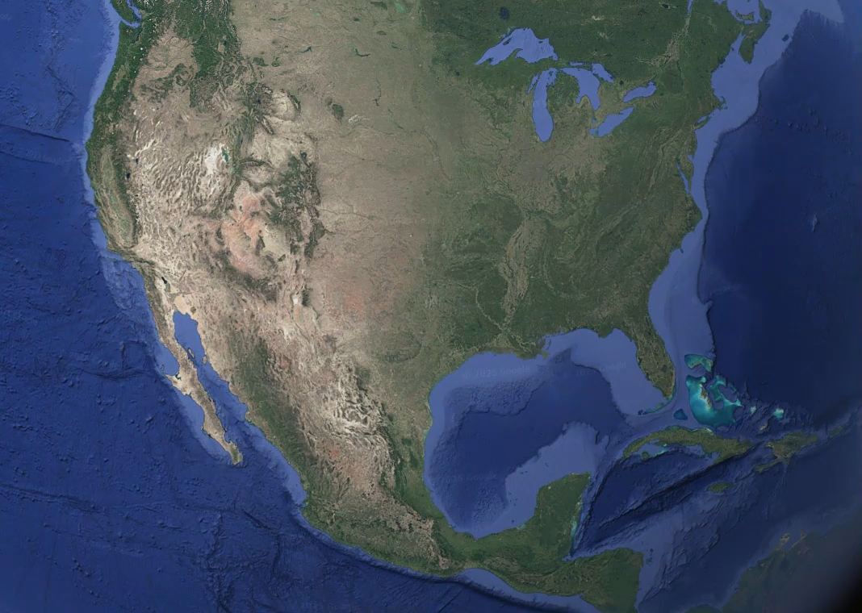
Notes:
Everything has mass….. So therefore, it takes up some form of space
So even though we may record something as a point – if you zoom in – it takes up some amount of space…..
That’s intuitively true for something like a city or county

Slide 31
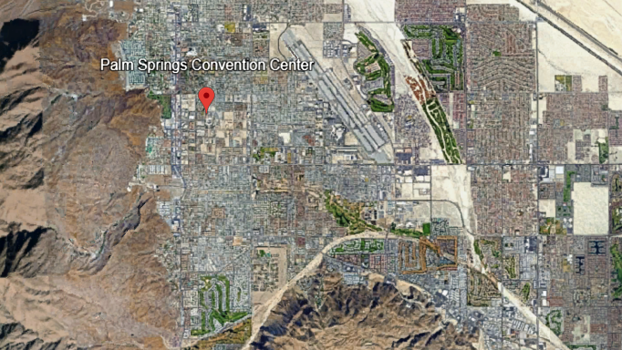
Notes:
Or a building

Slide 32
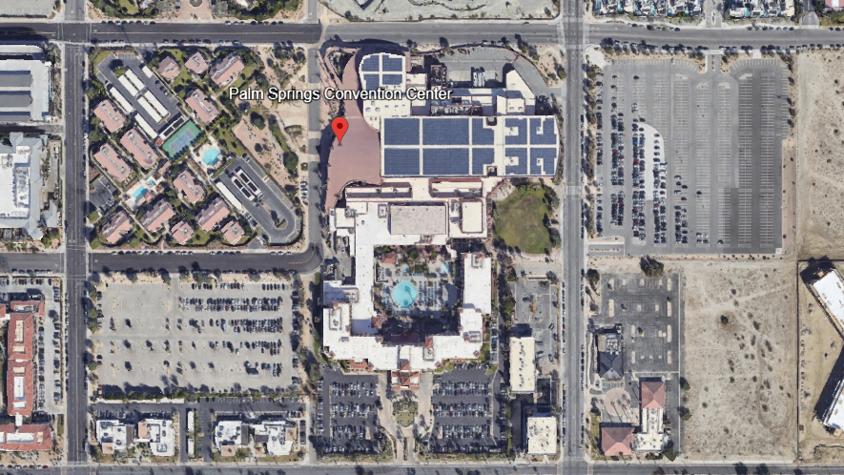

Slide 33
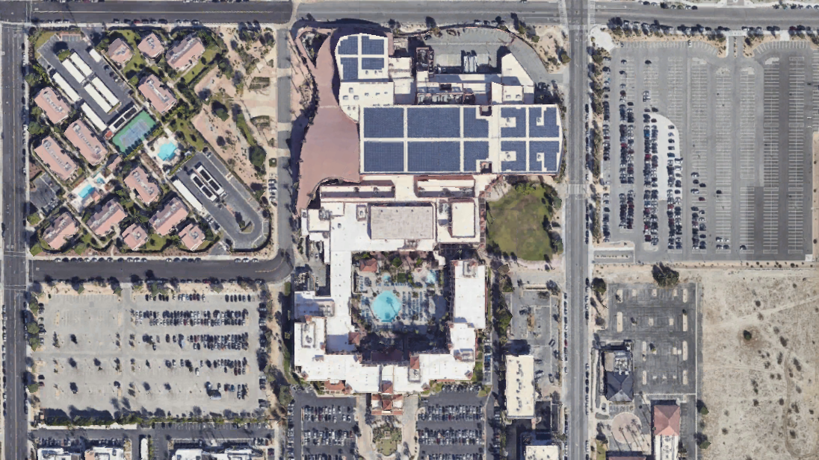

Notes:
Or a room…

Slide 34
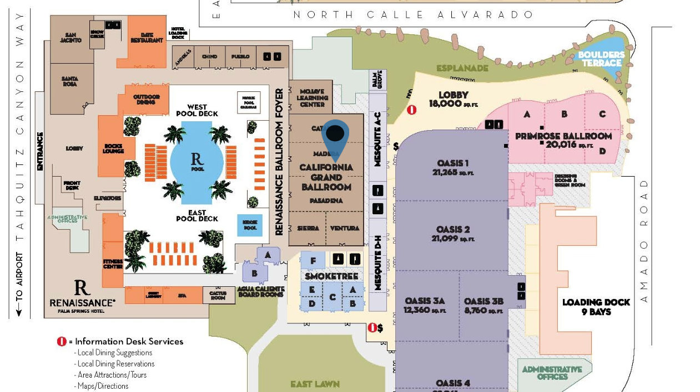


Notes:
It’s important to remember that that’s true for EVERYTHING
Including me …..
And the palnts we want to record…
Everything we record the location of has its own extent – or its own space that it takes up

Slide 35

Locality Extent
The spatial extent of a place
Notes:
So nothing we map is truly a singly point - Everything its own extent – or area that it takes up

Slide 36
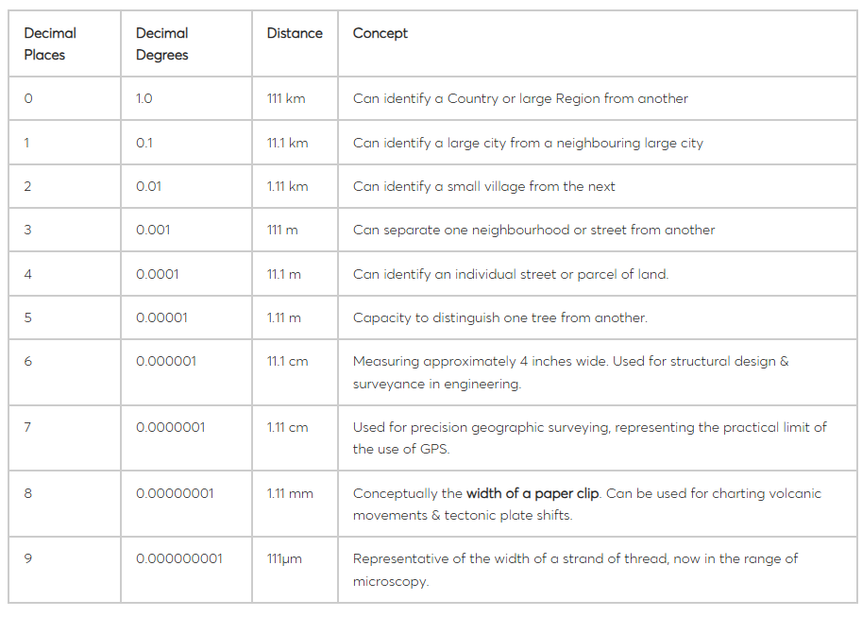
Coordinate Precision
https://blis.com/precision-matters-critical-importance-decimal-places-five-lowest-go/
Notes:
And while we think of a pair of coordinates as a specific point, in reality – recording coordinates captures not a point, but rather an area
And the coordinate precision dictates how big that given area is…
So depending on how precise your coordinates are – the specific point you identify on a map may be larger (or potentially smaller…..) than the actual extant of what it is that you are locating….. This is something that can factor into your overall uncertainty

Slide 37
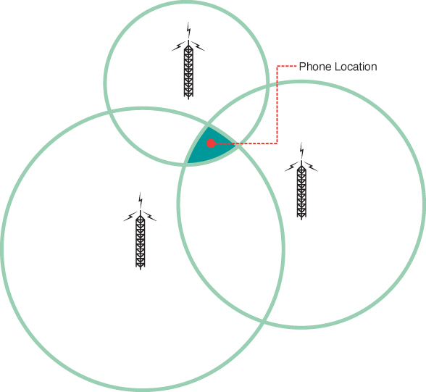
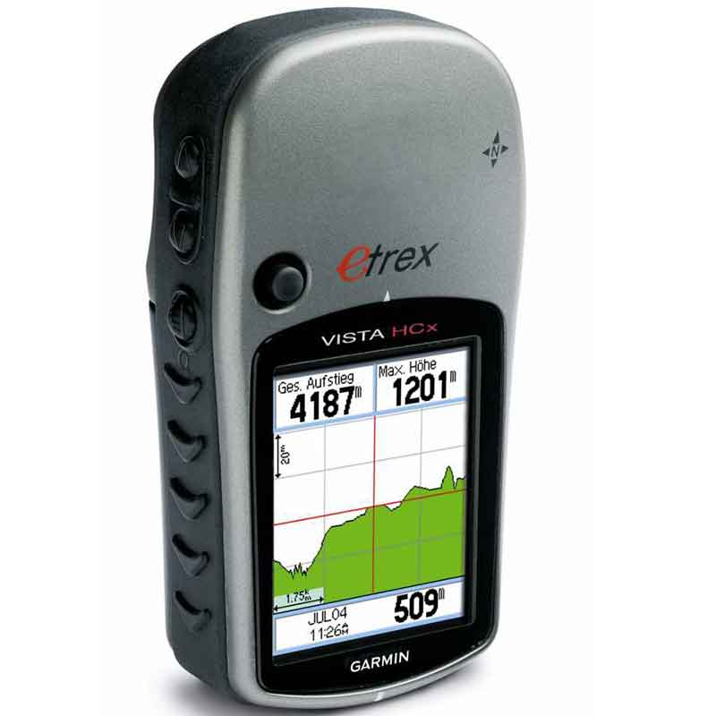

Coordinate Precision
GPS accuracy
https://blis.com/precision-matters-critical-importance-decimal-places-five-lowest-go/
Notes:
And therefore – the precision of whatever device you are using to record the location can affect your uncertainty…..

Slide 38
Uncertainty
Locality Description
Point Location
Map Comparisons
Distance measurement precision
Locality extent
Map scale and Coordinate Reference Systems
Coordinate Precision
and
Direction measurement precision
GPS accuracy
Notes:
Additionally – the way you actually map the Earth itself can impact the uncertainty

Slide 39
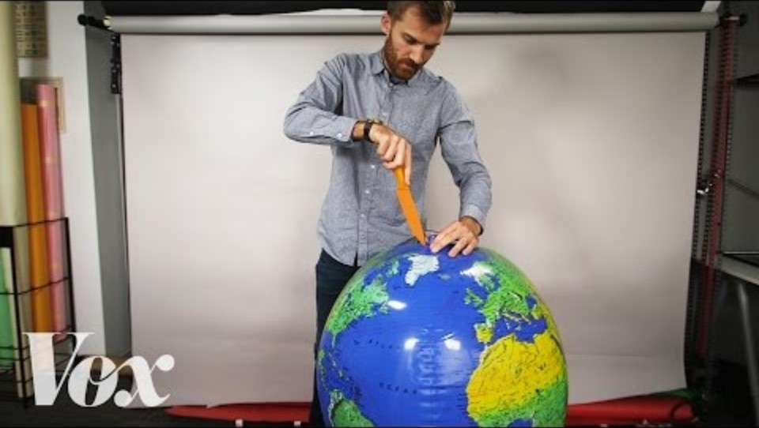
Notes:
For example – how you chose to visualize the map….

Slide 40
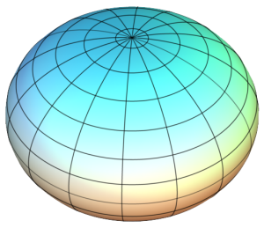
Geodetic Datums
Model of the Earth describing the size, shape, origin, and orientation of a coordinate system for mapping Earth’s surface
WGS84
Default for Google Maps – very common today
Others:
NAD27, NAD83
Notes:
Good link for talking more about coordinate reference systems:
https://docs.up42.com/data/reference/utm

Slide 41
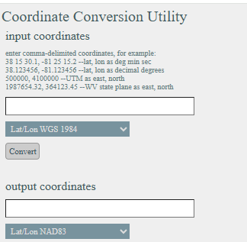
Geodetic Datums
Others:
WGS84
NAD27, NAD83
https://tagis.dep.wv.gov/convert/
Notes:
Can use a conversion tool, if needed for specific maps – if looking at something like Googlemaps or associated webpages to measure – odds are it will be WGS84
Good link for talking more about coordinate reference systems:
https://docs.up42.com/data/reference/utm

Slide 42
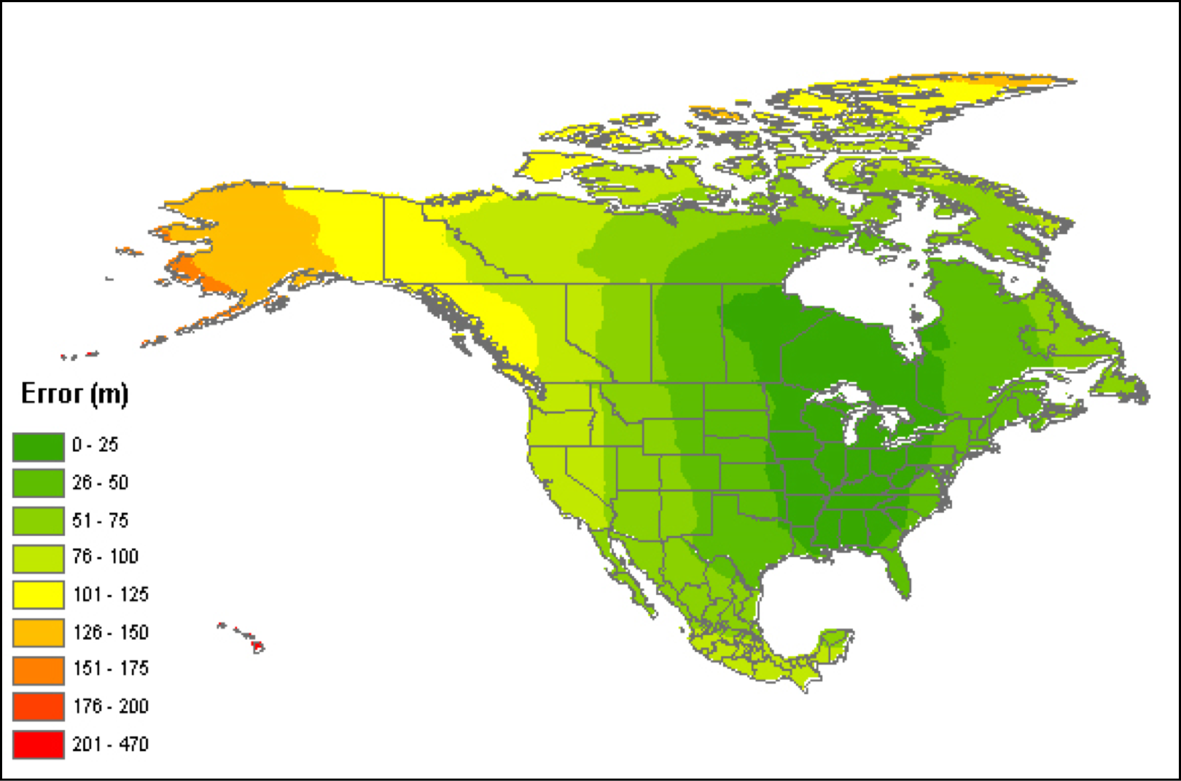
Error assuming NAD27 vs NAD83 or WGS84
https://georeferencing.org/docs/GeorefGuide.html
Notes:
But if don’t know – then there is error in assuming one, when in reality it is another datum
Because these different models use different mathmateical models and projections to represent Earth’s surface – consuming one with another can lead to error…. So not knowing which datum you’re using can also add to uncertainty
Note - the magnitude of error changes with location (because different projections…)

Slide 43
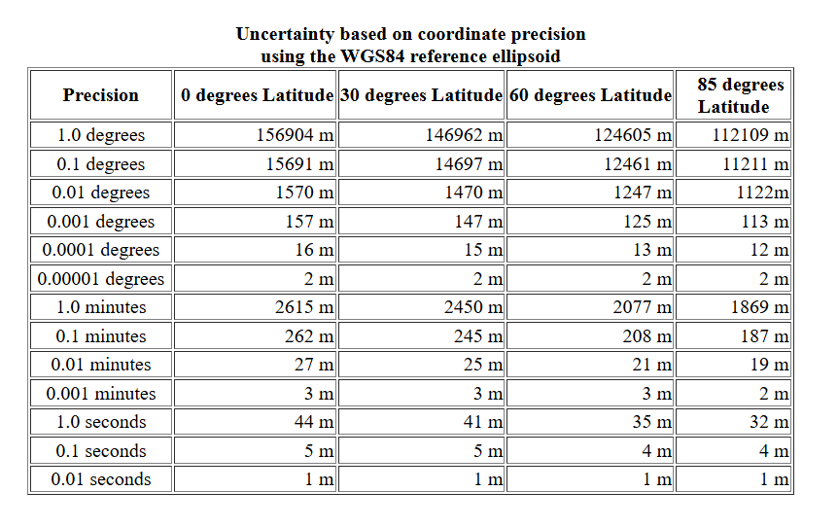
Coordinate Precision (revisited)
Notes:
Which also brings me back to touching on Coordinate Precision – note that the degree of uncertainty for coordinate precision can depend on latitude (for WGS84) – because of Mercator projection (with smaller area at the poles than at the equator)

Slide 44

Agenda
What is a georeference?
Why georeference?
Key Concepts
How do you georeference?

Slide 45


How do you georeference?
Manual Georeferencing
Georeferencing
Calculators
Notes:
Manual georeferencing: assigning coordinates using detailed topographic maps
- required meticulous interpretation of site descriptions
- Very time consuming – especially if have lots of samples

Slide 46
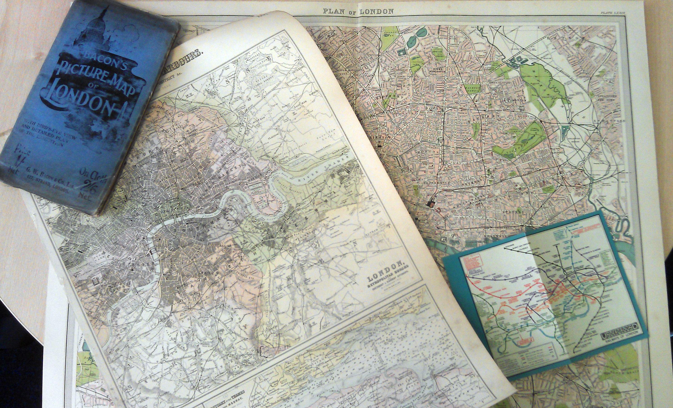
Manual Georeferencing
Notes:
Manual georeferencing: assigning coordinates using detailed topographic maps or using mapping resources to
- required meticulous interpretation of site descriptions
- Very time consuming – especially if have lots of samples

Slide 47
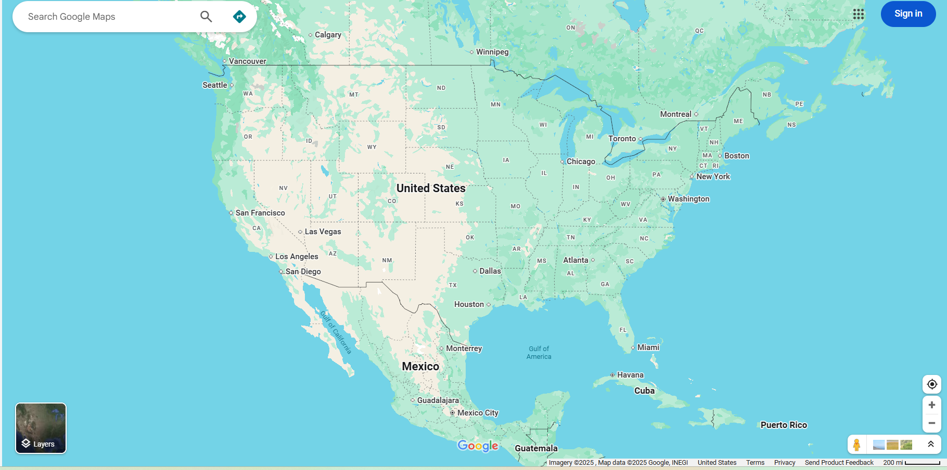

Google Maps

Slide 48
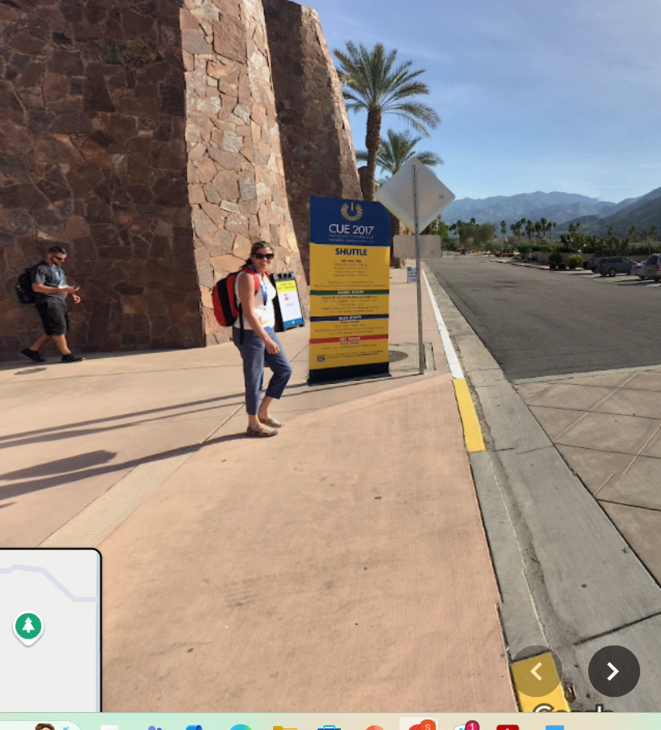
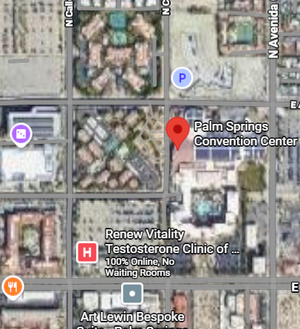
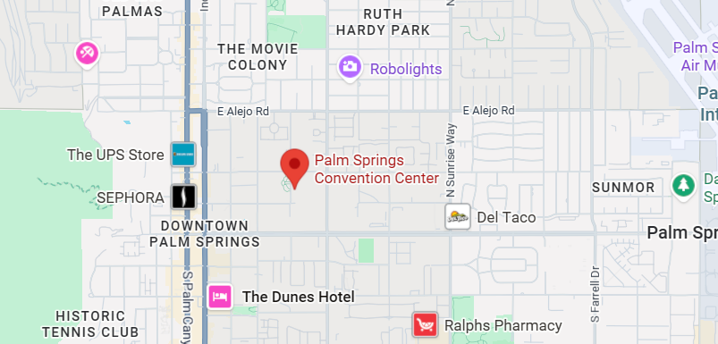
Google Maps
Easily searchable
Directions for traveling by car, bike, public transportation, or foot
Map views: map, satellite, terrain, Google Street View
Notes:
Search and directions
Free text search
Directions for traveling by car, bike, public transportation, or foot
Data compiled from different sources
Maps
Views: map, satellite, terrain, Google Street View
Sources of maps indicated at bottom

Slide 49
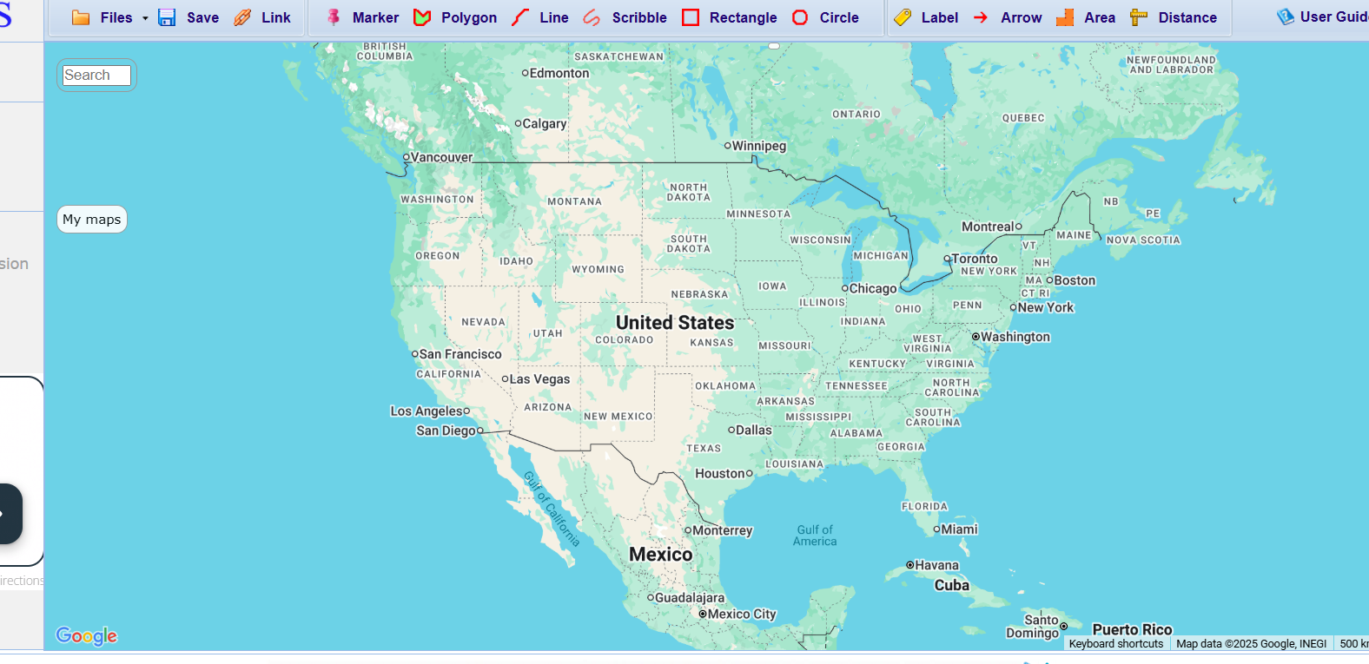


Slide 50
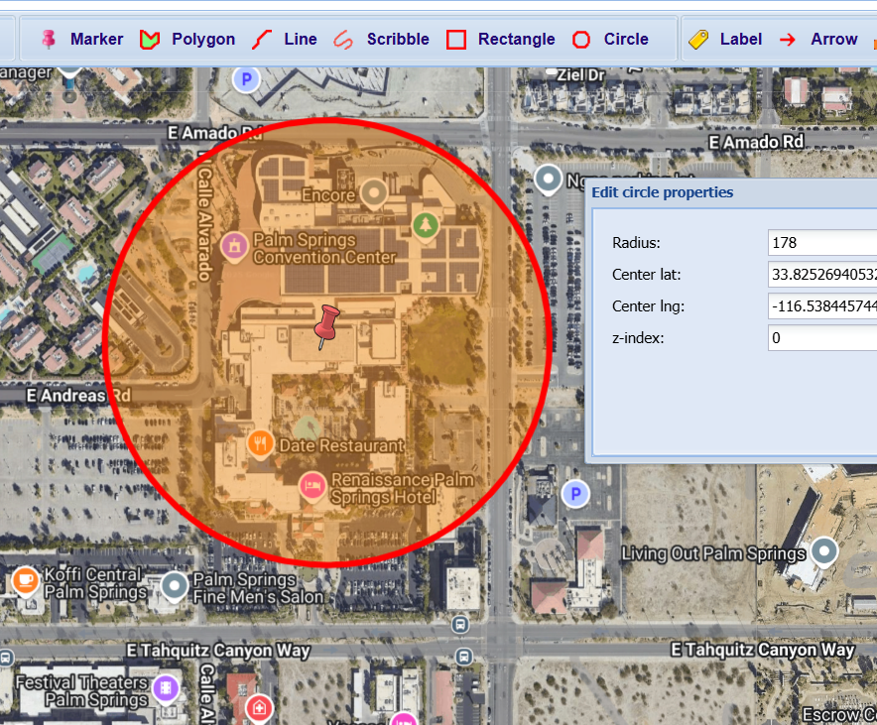
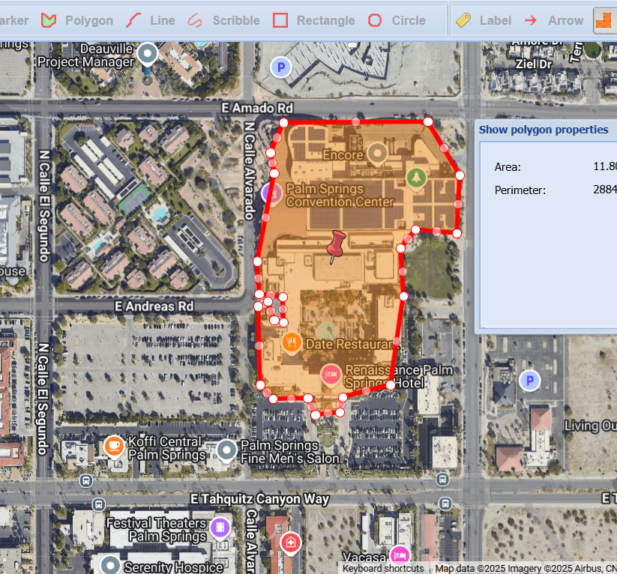
Google Map Layers
Zoom to Coordinates
Easy to draw/measure uncertainty

Slide 51
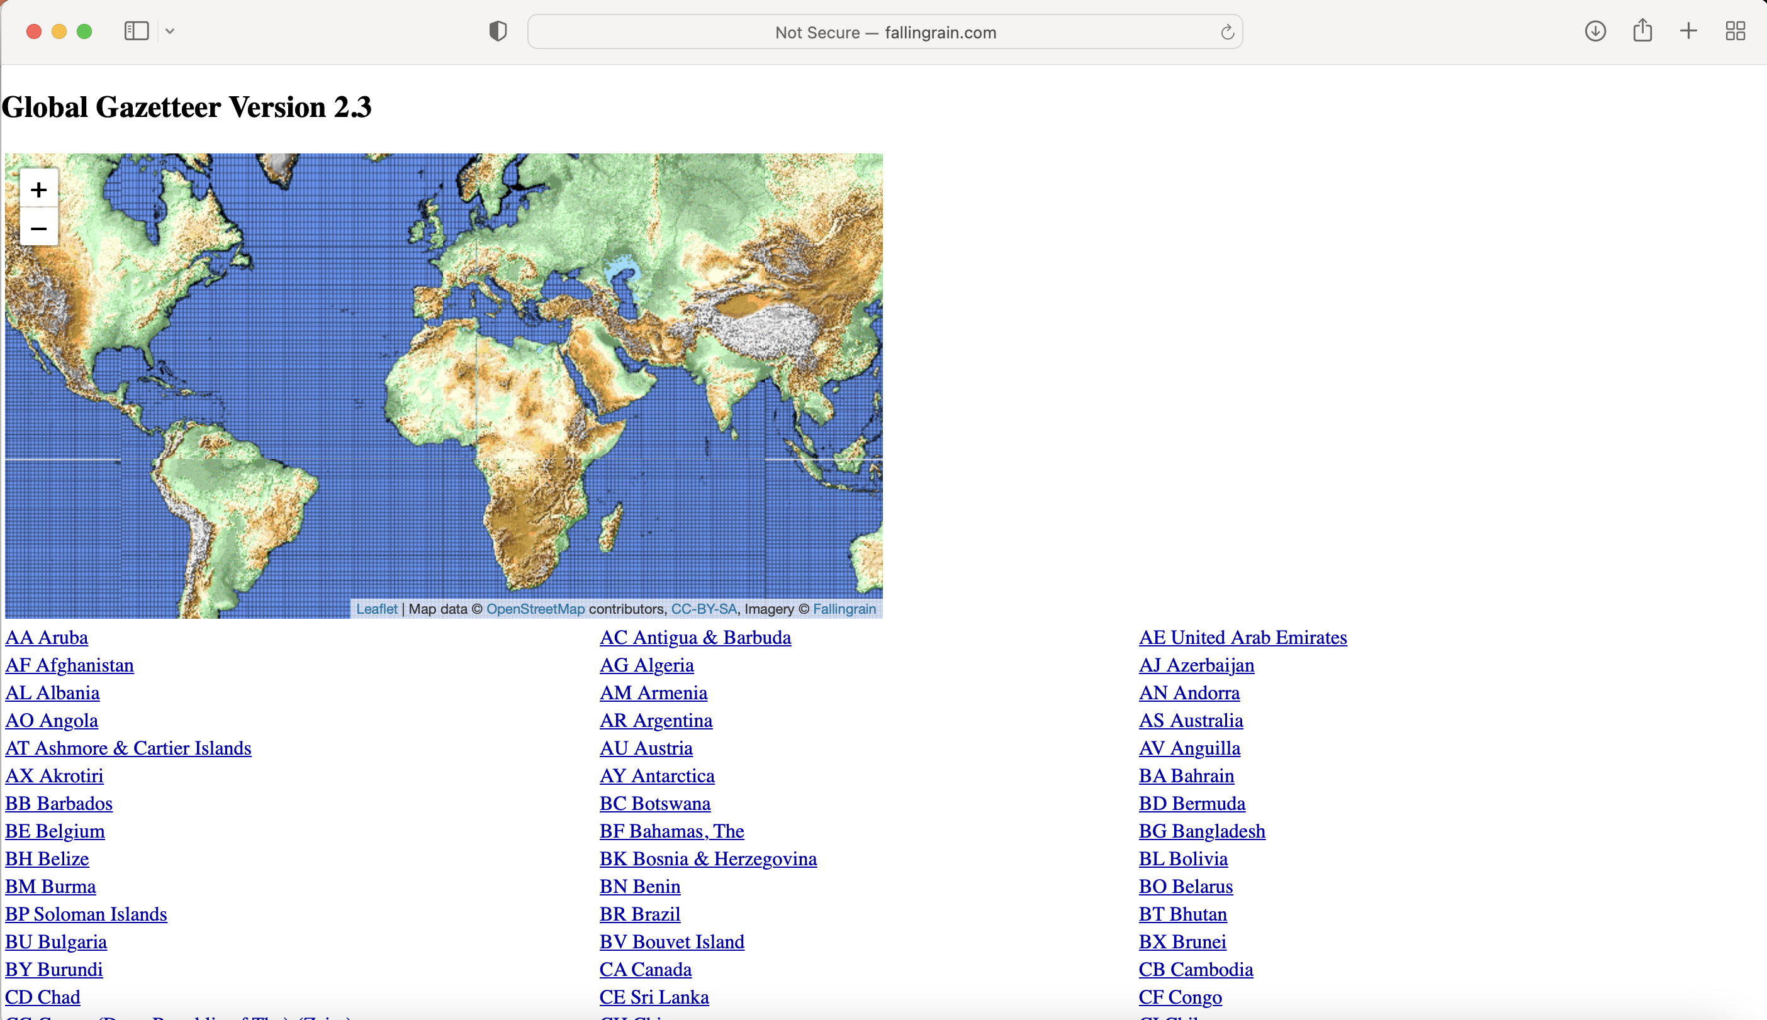
Falling Rain
https://www.fallingrain.com/world/
Worldwide gazetteer for cities and towns
Great for hard-to-find localities, especially outside US
Notes:
No search
Provides hierarchy, alternative names, altitude, weather information, and location of nearby towns
Example: Qaryeh-ye Gol’alam, Velayat-e Lowgar, AF
Really great because the name of cities - since names often change!

Slide 52
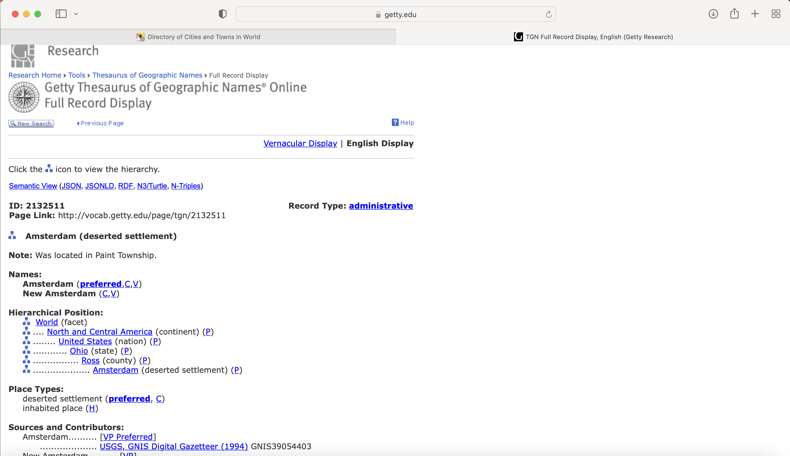
Degrees-minutes, not coordinates
Getty Thesaurus of Geographic Names (TGN)
http://bit.ly/Getty-TGN
Useful for alternative
and old names
Degrees-minutes,
not coordinates
Notes:
No search
Provides hierarchy, alternative names, altitude, weather information, and location of nearby towns
Example: Qaryeh-ye Gol’alam, Velayat-e Lowgar, AF
Really great because the name of cities - since names often change!

Slide 53
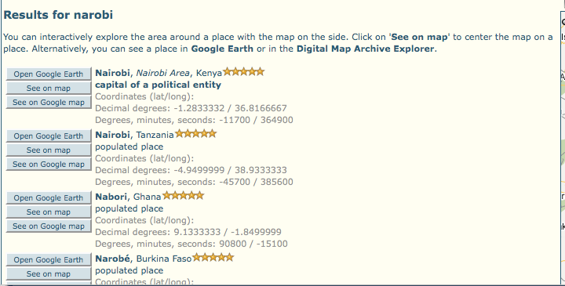
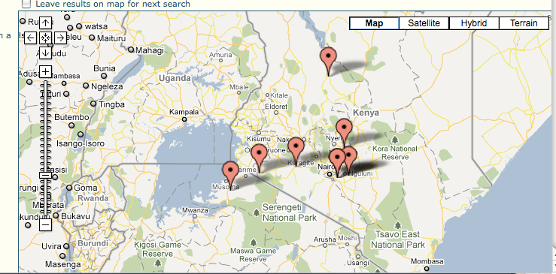
FuzzyG- JRC Fuzzy Gazetteer
designed for bad spelling
http://dma.jrc.it/services/fuzzyg/
Designed for bad spelling
Useful for finding alternative,
doubtful spelling,
and old names
Also good for translating
between languages
Notes:
Worldwide gazetteer designed for bad spelling
Critical for translating between languages
Useful for finding alternative, doubtful spelling, and old names
Feature types, by continent
Degree-minutes, not coordinates
Example: Narobi instead of Nairobi, Africa
Couldn’t get link to work or access it from google search….

Slide 54

Georeferencing Calculators

Slide 55
designed for bad spelling
Notes:
Has an automated process – so all you have to do is manual verification and adjustments

Slide 56
designed for bad spelling
Notes:
Worldwide gazetteer designed for bad spelling
Critical for translating between languages
Useful for finding alternative, doubtful spelling, and old names
Feature types, by continent
Degree-minutes, not coordinates
Example: Narobi instead of Nairobi, Africa
Couldn’t get link to work or access it from google search….

Slide 57
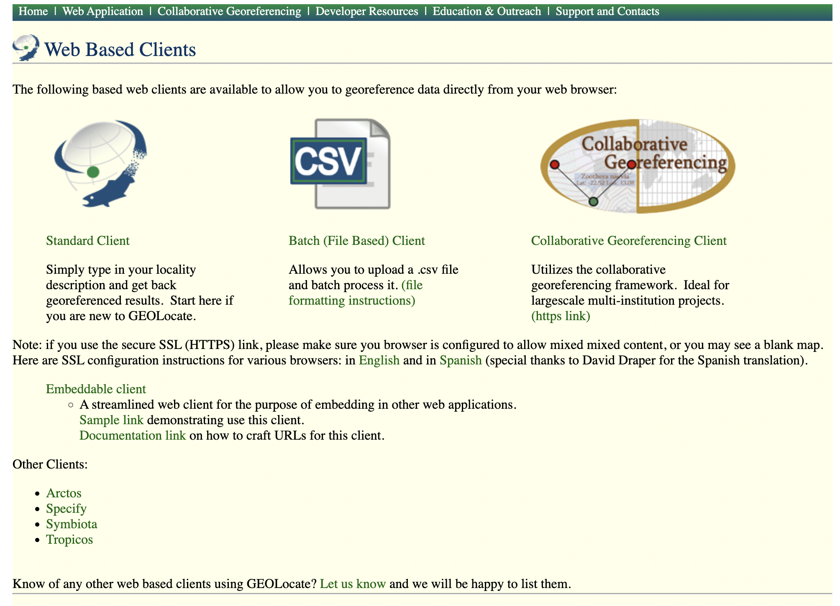
Single Reference Workflow

Slide 58
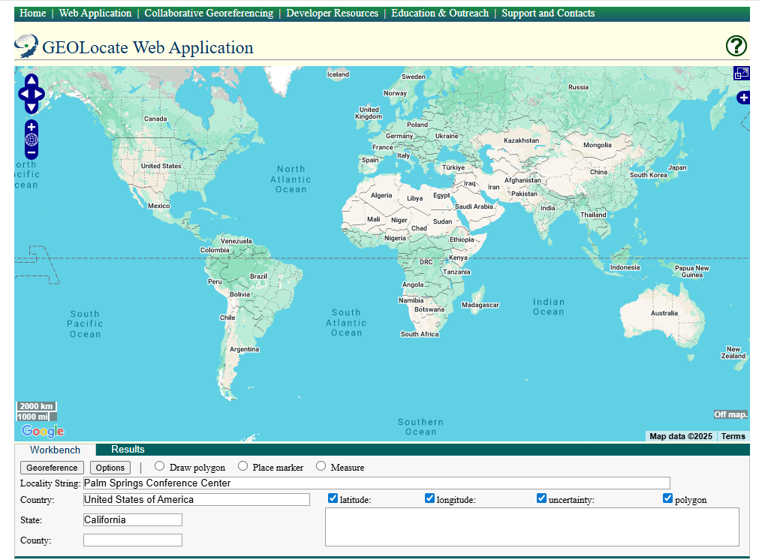

Slide 59
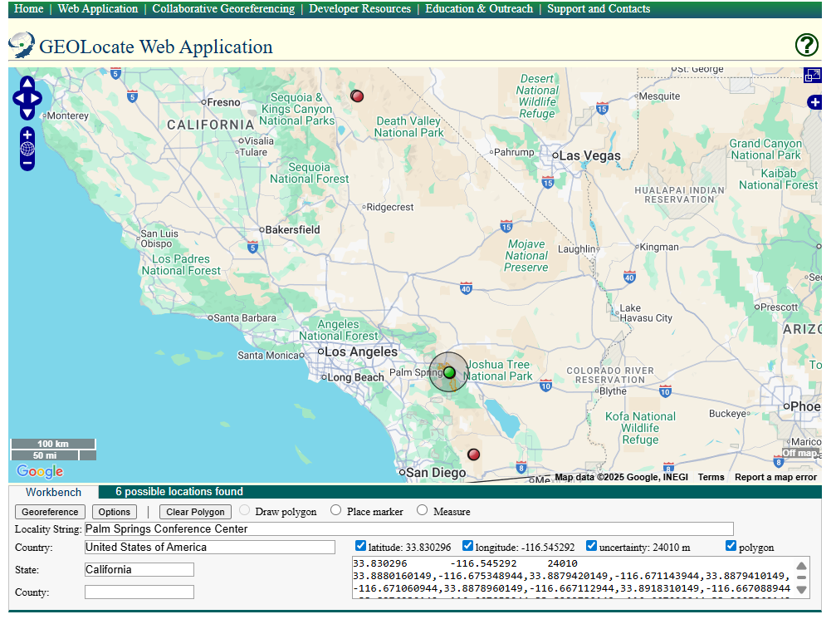

Slide 60
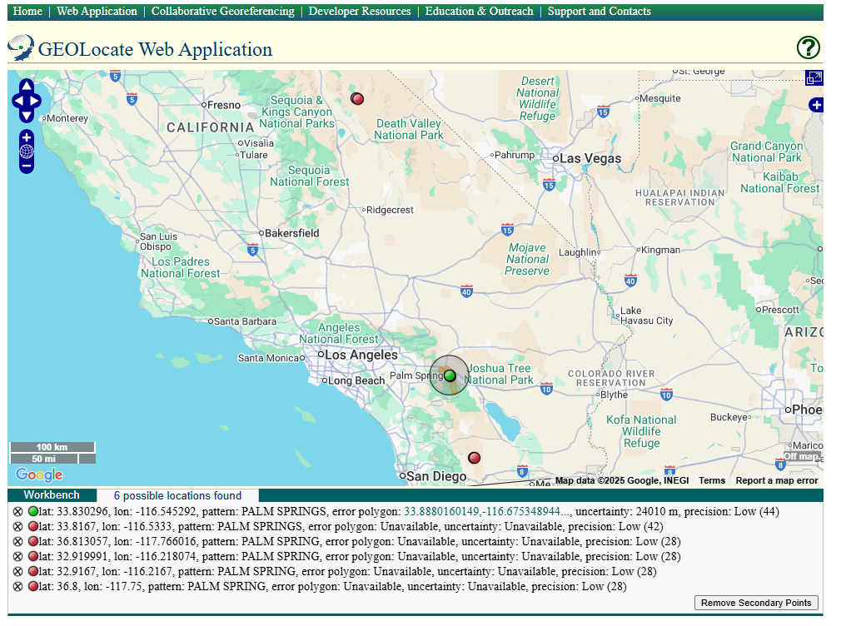

Slide 61
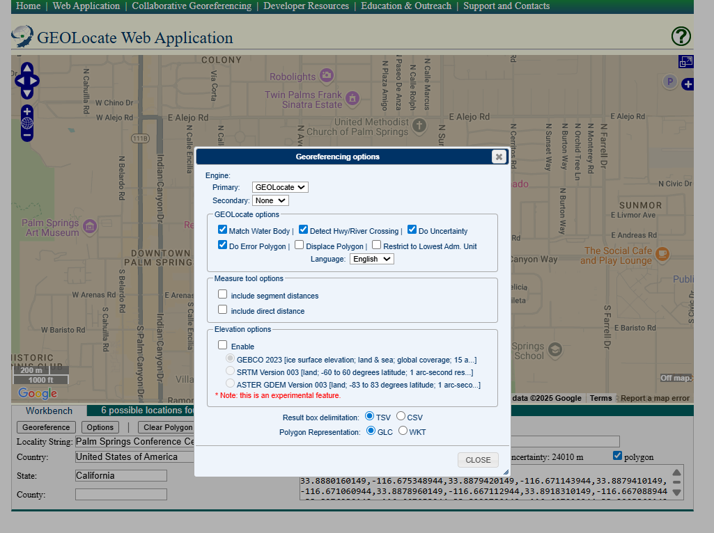
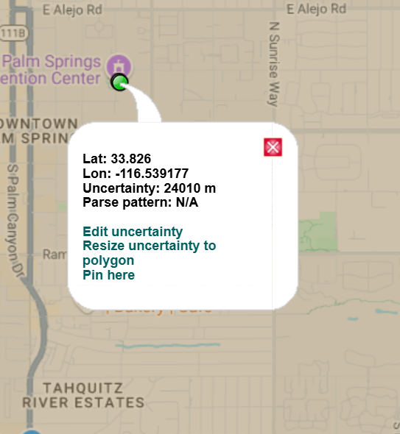
Notes:
CLEAR SCREEN

Slide 62
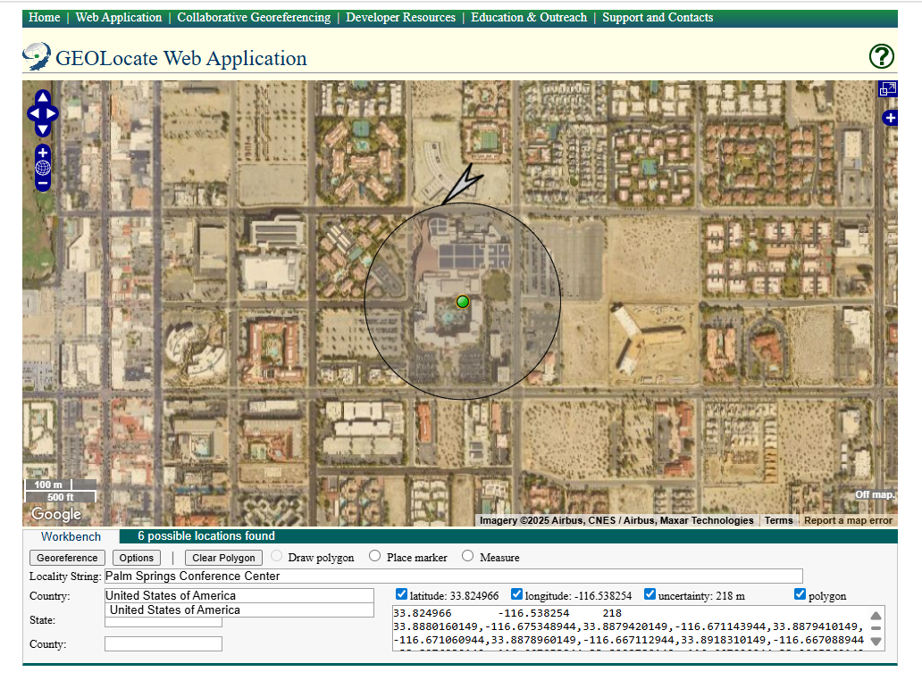

Slide 63
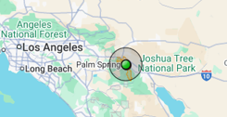
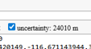

Slide 65
Batch Workflow

Slide 66
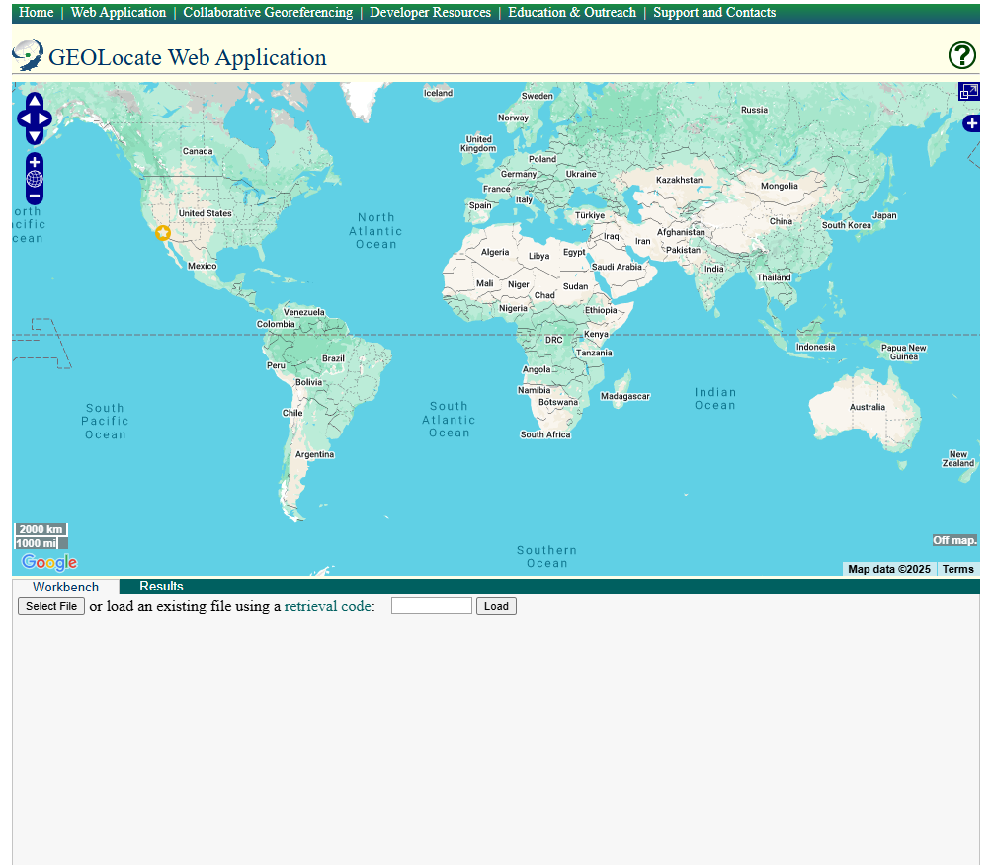

Slide 67


Slide 68


Slide 69


Slide 70


Slide 71


Slide 72


Slide 73


Slide 74


Slide 75


Other Resources
Georeferencing Quick Reference Guide
https://docs.gbif.org/georeferencing-quick-reference-guide/1.0/en/
Notes:
Manual georeferencing: assigning coordinates using detailed topographic maps
- required meticulous interpretation of site descriptions
- Very time consuming – especially if have lots of samples

Slide 76
Other Resources
https://www.idigbio.org/wiki/index.php/Georeferencing

Slide 77
Practice

Slide 78



